Slide 1
KNOWLEDGE DISTILLATION
&
QUANTIZATION
FOR MODULAR DL MODELS
Analysis of techniques for Modular DL models
By
Krishna Pranay Angara Ramasai Badam Nikhil Balachandra Vishnu Koppera

Slide 2
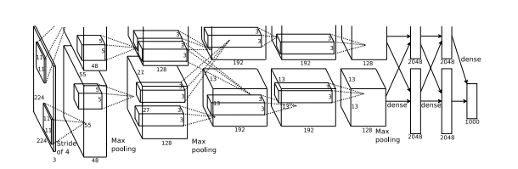
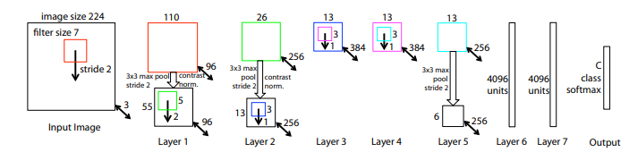
Design
Alexnet
Accuracy
Time
Model Size
Post Quantization Training
Metrics
Quantization Aware training
ZF net
Knowledge Distillation

Slide 3
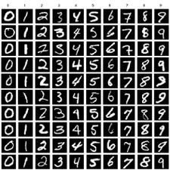
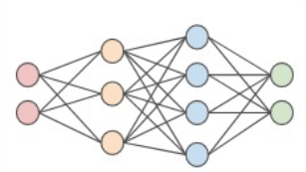
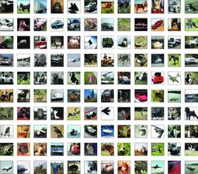
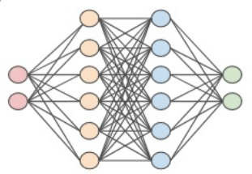
Pipeline
Data
Data Preprocessing
DL Models
MNIST
Data Augmentation
Data Scaling
CIFAR
Data typecasting

Slide 4
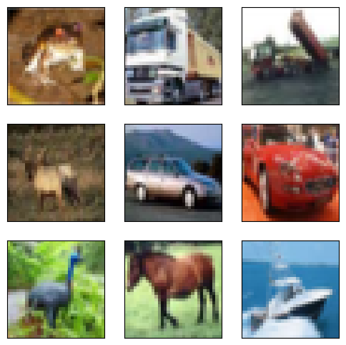
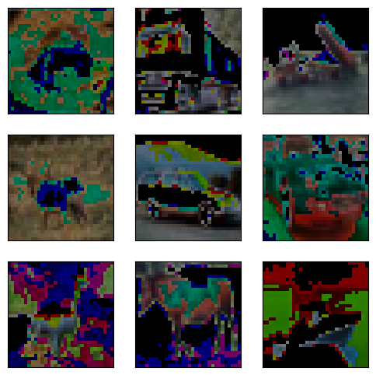
CIFAR Dataset
Float32
32 * 32 * 3 * 50000 = 15,360,000 bytes = 14.64MB
int8
32 * 32 * 3 * 50000 * 1 / 8 = 1,920,000 bytes = 1.83 MB
Array Datatype casting
87.45%
reduction

Slide 5
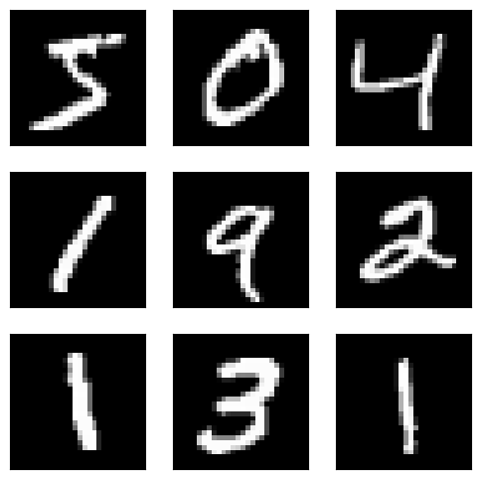
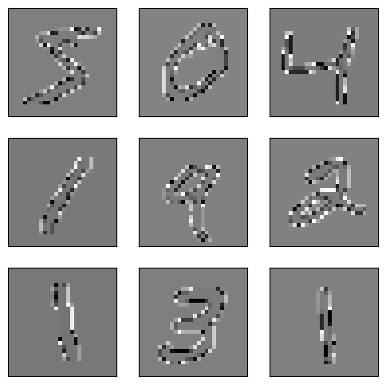
MNIST Dataset
Float32
28 * 28 * 1 * 60000 = 47,040,000 bytes = 44.89 MB
int8
28 * 28 * 1 * 60000 * 1 / 8 = 5,880,000 bytes = 5.59 MB
Array Datatype casting
87.53%
reduction

Slide 6
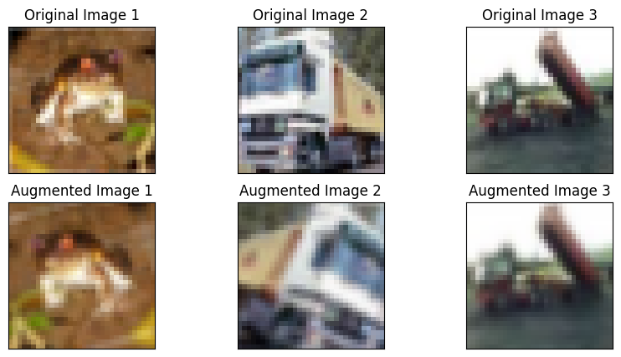
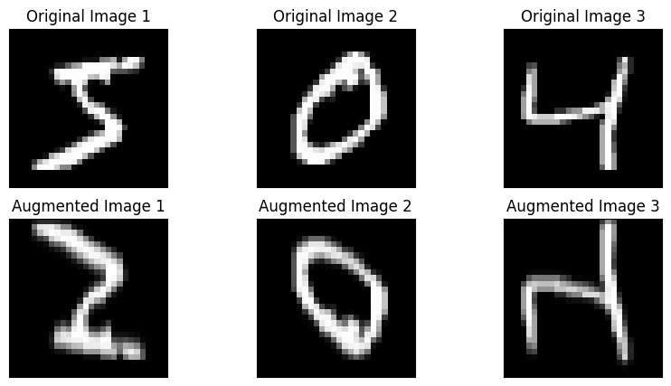
Data Augmentation
Augmentation
Augmentation

Slide 7
88.76%
Reduction
Model Size
Post Quantization Training
Models | dataset | tflite_accuracy | OG_Accuracy | folder (MB) | time (mins) | tflite size
alexnet | cifar_float | 72.71% | 72.76% | 4.86 | 18.419 | 561 KB
 | cifar_int8 | 62.47% | 63.49% | 4.86 | 17.40333 | 561 KB
 | mnist_float | 99.42% | 99.43% | 3.98 | 18.396 | 446 KB
 | mnist_int8 | 99.32% | 99.39% | 3.98 | 17.9495 | 446 KB
zfnet | cifar_float | 73.88% | 73.97% | 279 | 60.16983 | 34.8 MB
 | cifar_int8 | 60.97% | 60.97% | 279 | 62.4045 | 34.8 MB
 | mnist_float | 99.38% | 99.37% | 279 | 52.84917 | 34.8 MB
 | mnist_int8 | 95.54% | 95.52% | 279 | 53.3955 | 34.8 MB
>90 secs
reduction
Time
0.05%
Reduction
Accuracy

Slide 8
89.76%
Reduction
Model Size
Quantization Aware Training
Model | Dataset | model name | Trainable parameters | Accuracy | Time | Size
Alexnet | cifar | cifar_augqat_model.h5 | 551,722 | 84.6% | 64 mins | 4.32MB
 |  | cifar_augqatnorm_model8 | 551,722 | 12.89% | 63.45 mins | 4.32MB
 |  | cifar_augqat_model8 | 551,722 | 77.18% | 63.8 mins | 4.32MB
 | mnist | mnist_augqat_model.h5 | 436,458 | 99.39% | 18.5 mins | 3.44MB
 |  | mnist_augqatnorm_model8.h5 | 436,458 | 42.71% | 18.083 mins | 4.32MB
 |  | mnist_augqat_model8.h5 | 436,458 | 98.6% | 19.42 mins | 3.44MB
Zfnet | cifar | cifar_zfaugqat_model.h5 | 36,483,914 | 83.6% | 103 mins | 4.32MB
 |  | cifar_zfaugqatnorm_model8.h5 | 36,483,914 | 14.7% | 96.7 mins | 4.32MB
 |  | cifar_zfaugqat_model8.h5 | 36,483,914 | 73.14% | 101.1 mins | 4.32MB
 | mnist | mnist_zfaugqat_model | 36,474,506 | 98.9% | 63.42 | 278.5MB
 |  | mnist_zfaugqat_model8 | 36,474,506 | 96.21% | 63.57 | 278.5MB
 |  | mnist_zfaugqatnorm_model8 | 36,474,506 | 20.17% | 63.04 | 278.5MB
>900 secs
increment
Time
>12%
increment
Accuracy

Slide 9
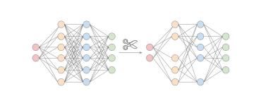
Knowledge Distillation
Model | Model name | Trainable parameters | Accuracy | Time | Size
Alexnet | Teacher | 76,009,832 | 52.98% | 326 seconds | 293MB
 | Student | 343,768 | 44.9% | 41 seconds | 3.99MB
Zfnet | Teacher | 25,657,448 | 42.19% | 97 seconds | 4.32MB
 | Student | 343,768 | 40.50% | 82 seconds | 3.9MB
68 secs
time
Distiller 1
45%
Accuracy
Distiller 1
68 secs
time
Distiller 2
58%
Accuracy
Distiller 2

Slide 10
Conclusion
Post Quantization Training
Quantization Aware Training
88.76%
memory
>90 secs
0.05%
Accuracy
88.76%
memory
>100 secs
12%
Accuracy
Knowledge Distillation
10%
Memory
reduction
>10 secs
30%
increment
Accuracy

Slide 11
Future work
Data Preprocessing
Metrics
Data Augmentation
Accuracy
Time
Model Size
Latency
Quantization Aware training
Data Scaling
Knowledge Distillation
Data typecasting

Slide 12
Questions?

